Slide 1
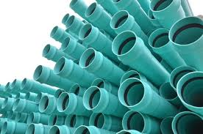
PVC Polyvinyl Chloride
Student Name

